Slide 1
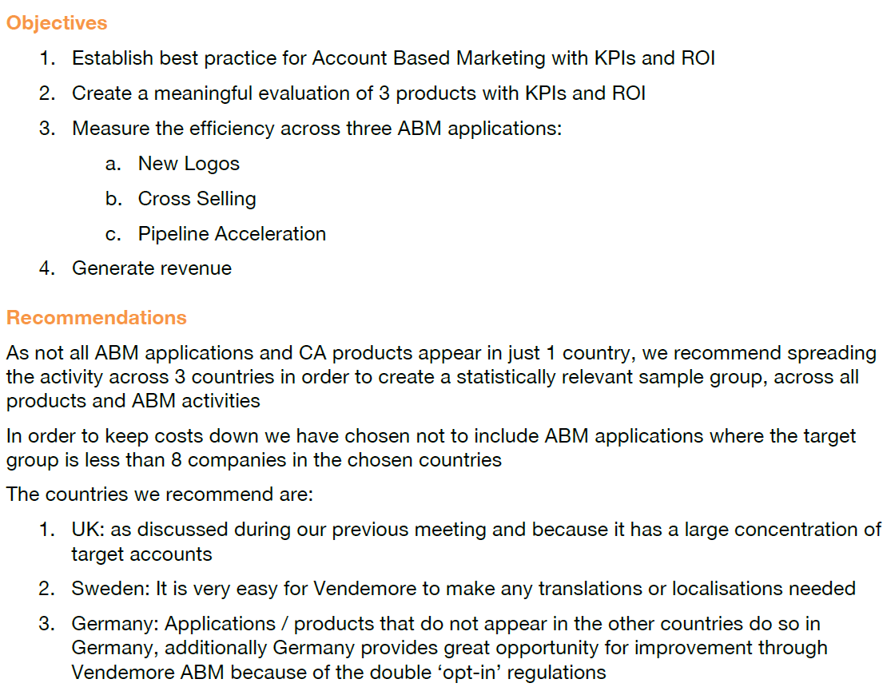
Vendemore Proposal

Slide 2
Vendemore Target Accounts Segmentation Approach
 | Security | IM | AP
New Logo | If account is considered as “Whitespace” for Security AND has NOT purchased any other CA solution | If account is considered as “Whitespace” for IM AND has NOT purchased any other CA solution | If account is considered as “Whitespace” for AP AND has NOT purchased any other CA solution
Cross Sell | If account is “Whitespace” for Security AND has already purchased any other CA solution | If account is “Whitespace” for IM AND has already purchased any other CA solution | If account is “Whitespace” for AP AND has already purchased any other CA solution
Move Pipe | If account is in the pipeline for Security products | If account is in the pipeline for IM products | If account is in the pipeline for AP products
130

Slide 3
Algorithm (Data analysis in Excel; Data source: Whitespace Account List provided by Sales Operation)
If any of the cross-sell is true
if any of the new logo or move pipe is true
If cross-sell for one BU
(account is “Whitespace” for BU «X»
account has already purchased any other BU’s licenses in the past 3 years AND account has not purchased any licenses in the other 2 BU AND account is not an opportunity in the other 2 BU )
If cross-sell for at least one BU
If new logo for one BU
If move pipe for one BU
if new logo for at least one BU
if move pipe for at least one BU
Look at the cross-sell correlation (account has
Purchased products in BU «Y» )
Cannot be the case
Move pipe for BU «X»
Look at the industry attribute of this account
Same approach as new logo for at least one BU
Decide BU «X» is the most probable one for accounts who already purchased BU «Y»
Decide BU «X» is the most successful one for the industry that account is in
Cross-sell for BU «X»
New logo for BU «X»
Cross-sell for BU «X»

Slide 4
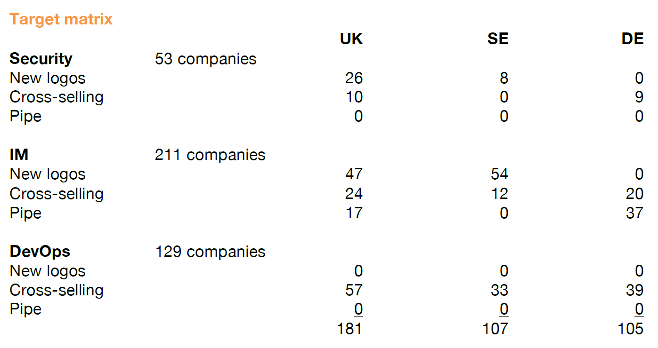
Vendemore Target Accounts Results

Slide 5
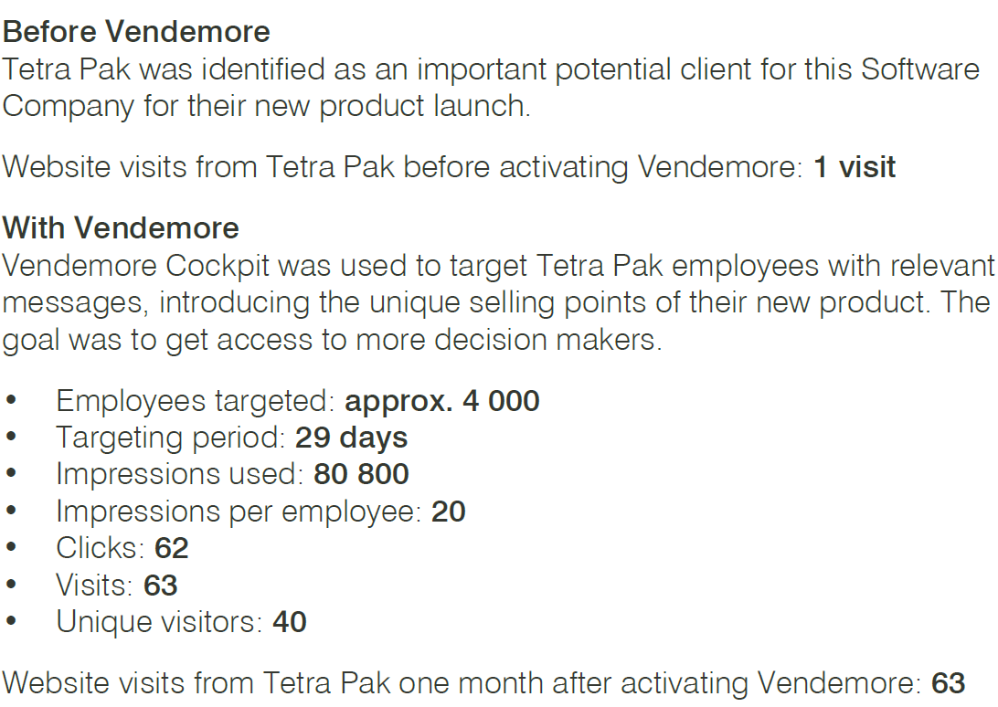
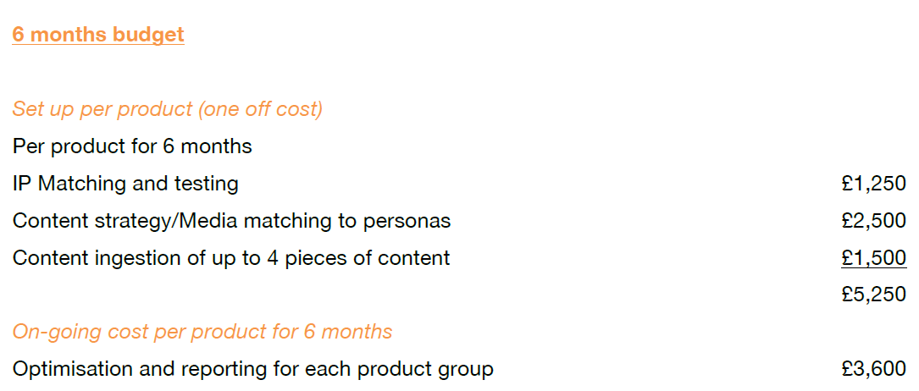
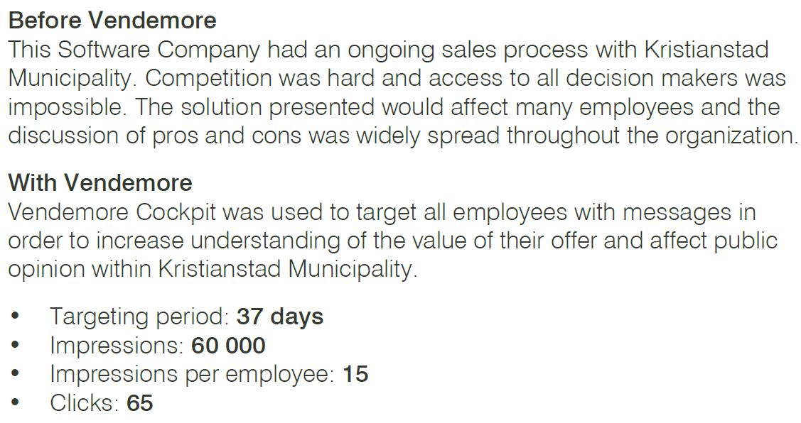
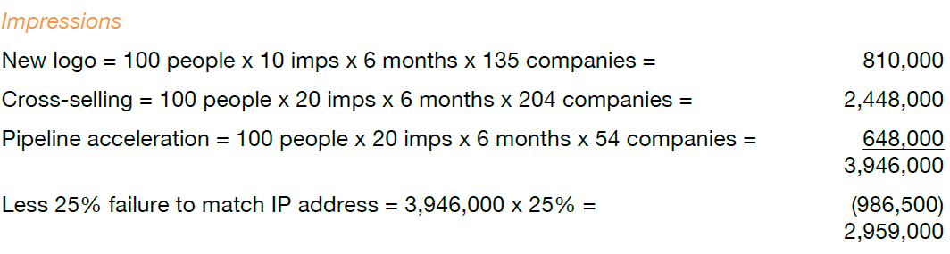
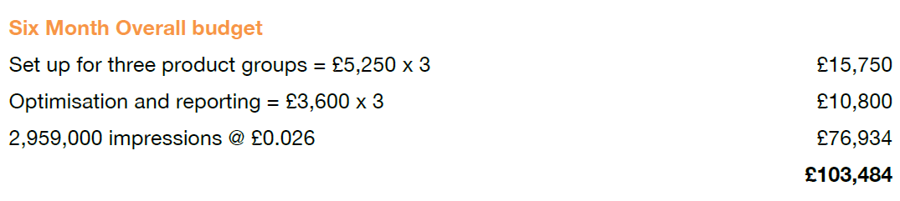
Vendemore Budget
Data from Vendemore Case Study
Impressions per employee: 15 to 20
Click-through rate: 0.08% to 0.11%

Slide 6


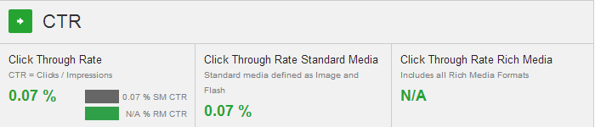
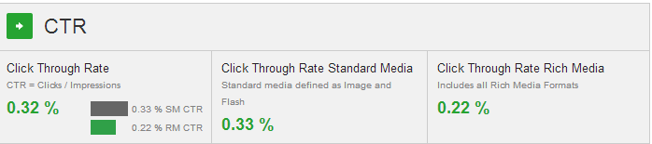

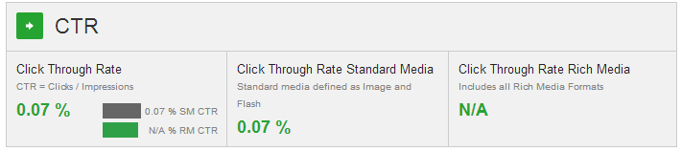
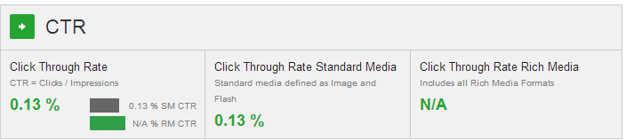
Industry Benchmark of Display Campaigns
Source: DoubleClick by Google Display Benchmarks Tools
http://www.richmediagallery.com/benchmarks

Slide 7
Whitespace in 3 BUs Whitespace in 1 BU, move pipe in the other 2 BUs Whitespace in 2 BUs, move pipe in the 3rd one Move pipe in 1 BU, cross-sell in the other 2 BUs Move pipe in 2 BUs, cross-sell in the 3rd one Move pipe in 3 BUs Cross-sell in 2 BUs, already purchased one in the 3rd one Cross-sell in all 3 BUs, already purchased one in another BU othan than those 3 Not whitespace, not move pipe, not cross-sell in either of those 3 BUs (e.g. account is a move pipe in another BU)
List of possible combinations of exceptional cases:

